Slide 1
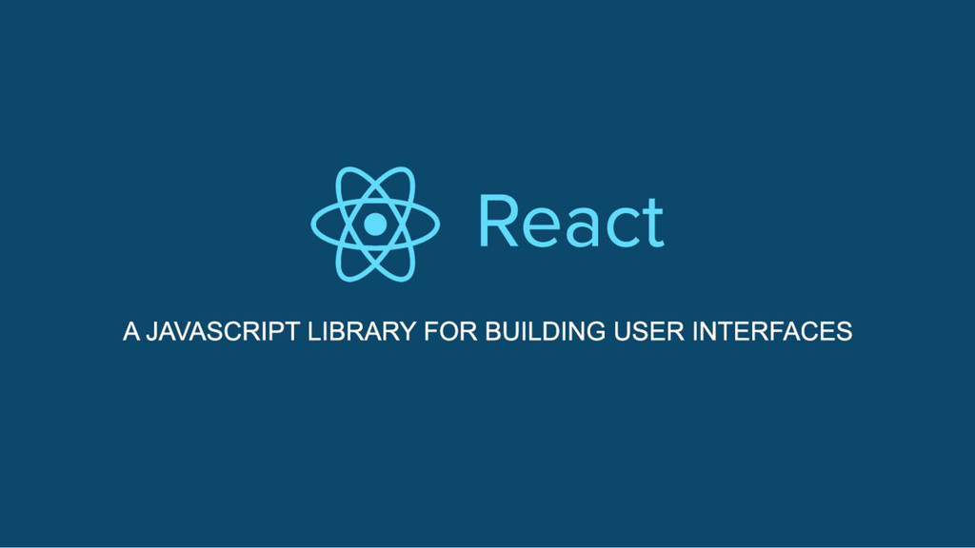

Slide 2
Table of Content
Introduction to JS frameworks, SPA, Webpack, Advantage of React.js over other frameworks
Real DOM vs Virtual DOM
Environment Setup, create-react-app cli
JSX, Props, State
Stateful vs Stateless Components
Component Lifecycle
Refs & Keys

Slide 3
Introduction to JS frameworks, SPA, Webpack & Advantage of React.js over other frameworks

Slide 4
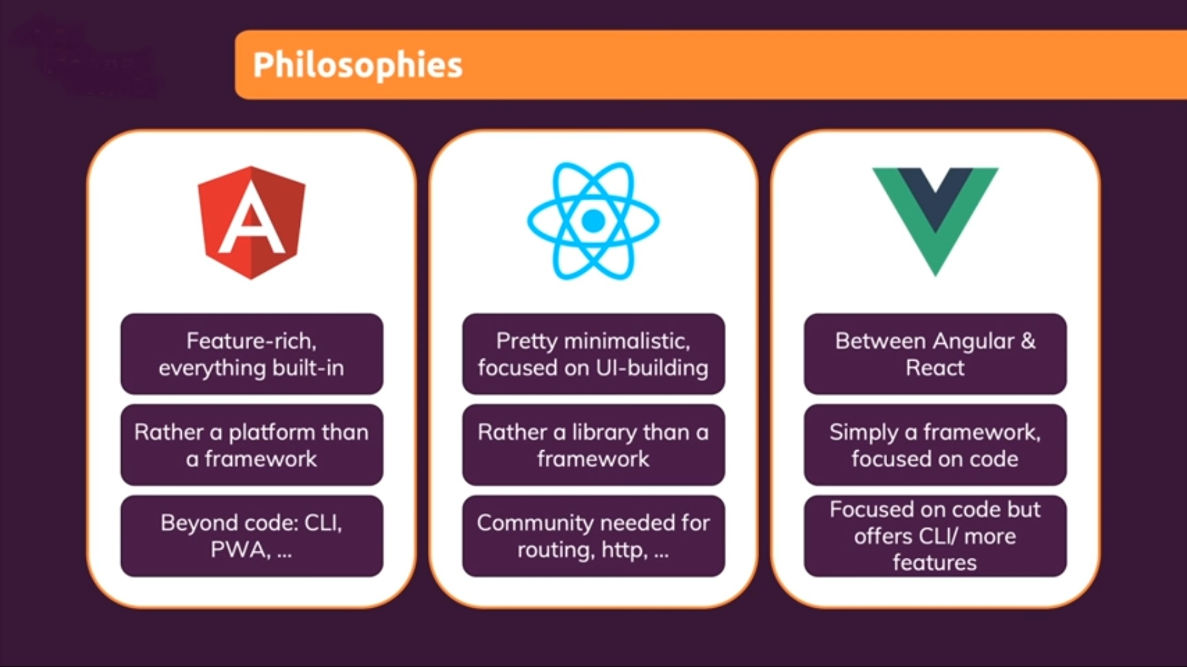
Popular JavaScript Frameworks

Slide 5
Feature Comparison

Slide 6
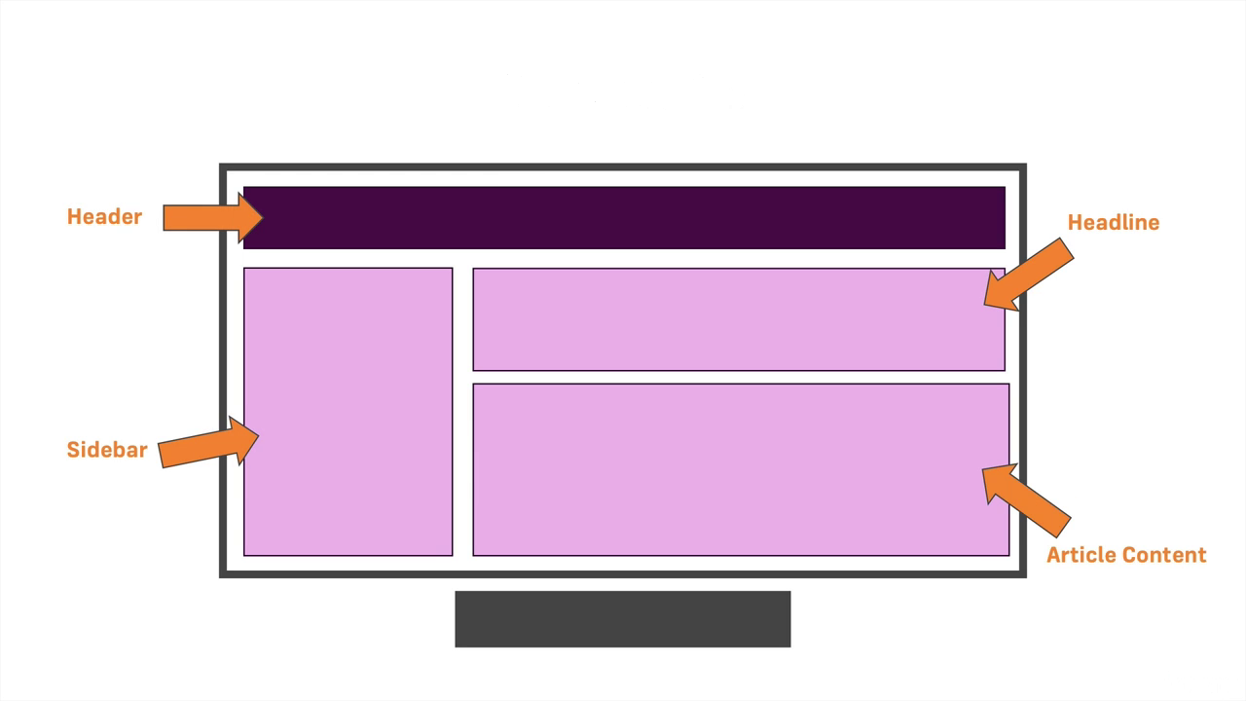
What are Components?

Slide 7
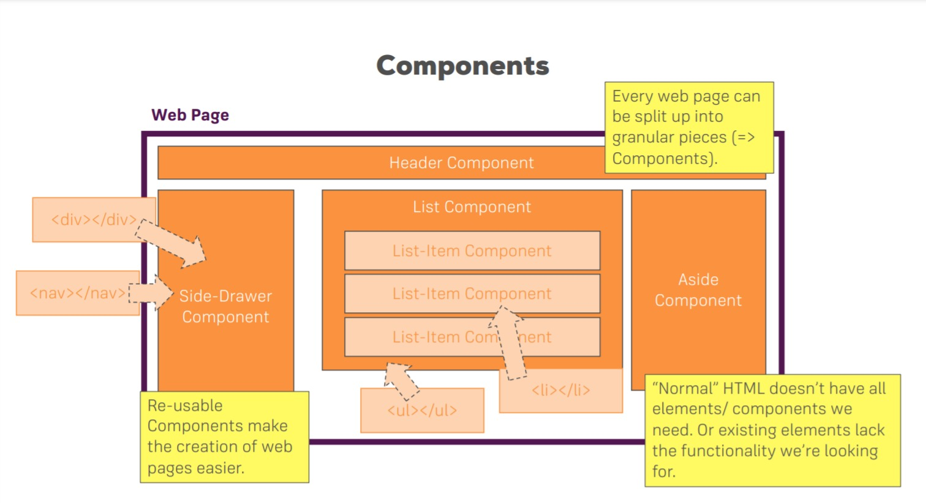

Slide 8
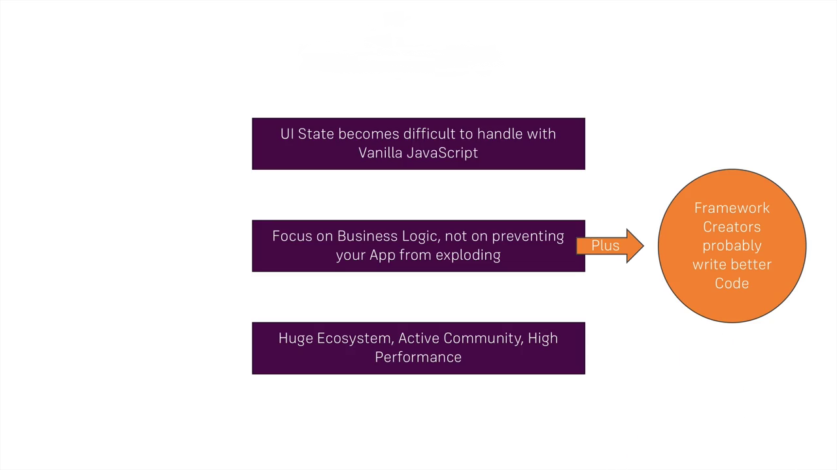
Why do we need JavaScript Frameworks?

Slide 9
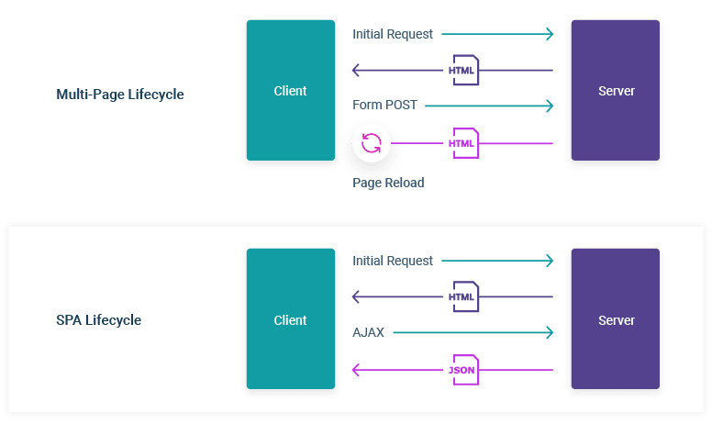
What is a Single Page Application(SPA)?

Slide 10
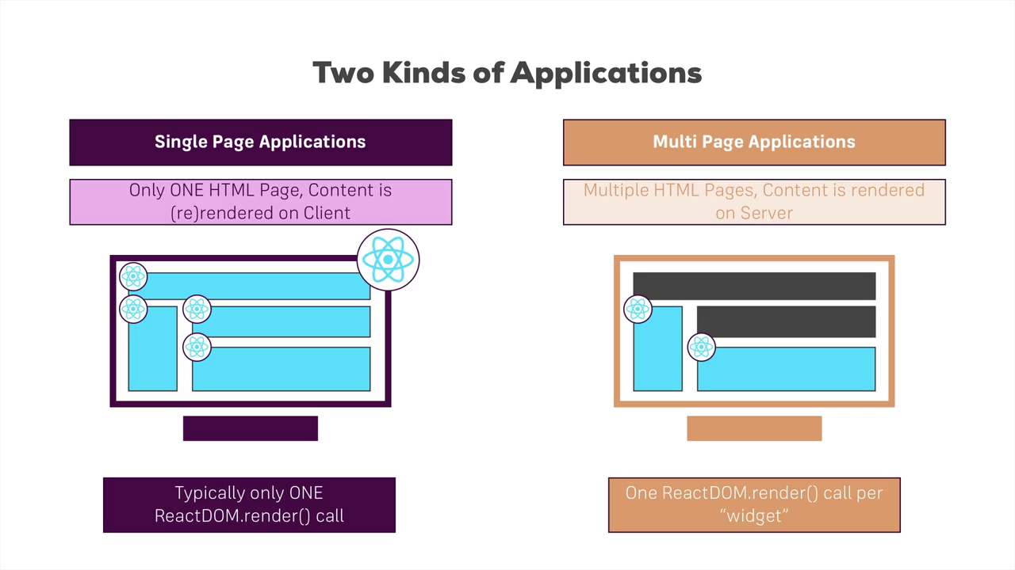
SPA & MPA in React

Slide 11
What is Webpack?
Webpack is a tool that lets you compile JavaScript modules, also known as module bundler.
Given a large number of files, it generates a single file (or a few files) that run your app.
It can perform many operations:
helps you bundle your resources.
watches for changes and re-runs the tasks.
can run Babel transpilation to ES5, allowing you to use the latest JavaScript features without worrying about browser support.
can transpile CoffeeScript to JavaScript
can convert inline images to data URIs.
allows you to use require() for CSS files.
can run a development webserver.
can handle hot module replacement.
can split the output files into multiple files, to avoid having a huge js file to load in the first page hit.
can perform tree shaking.

Slide 12
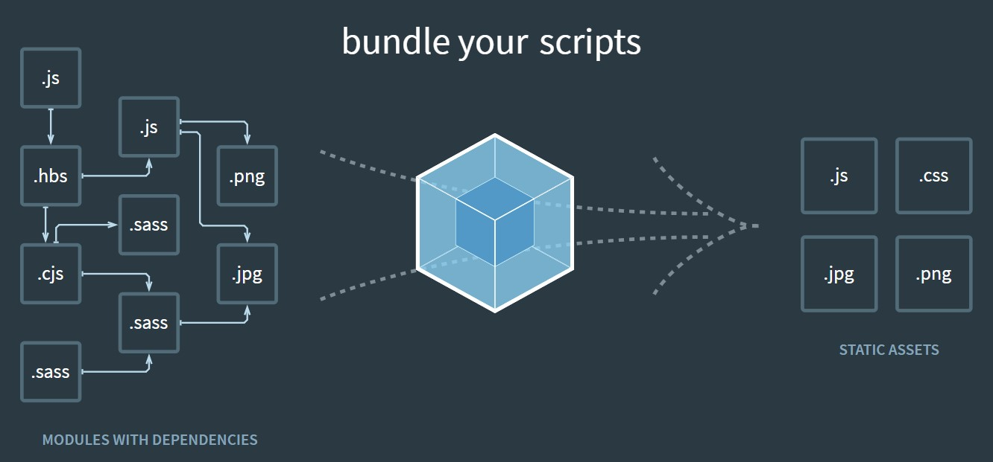

Slide 13
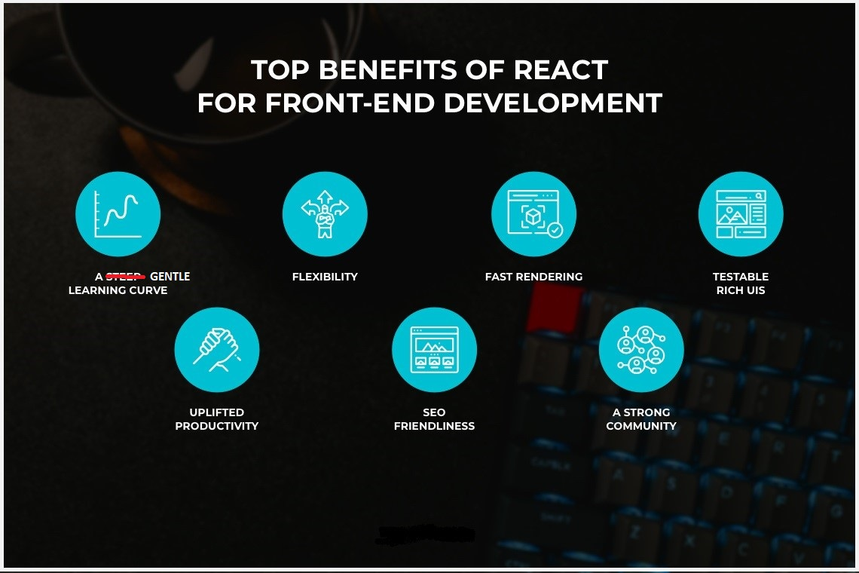

Slide 14
Real DOM vs Virtual DOM

Slide 15
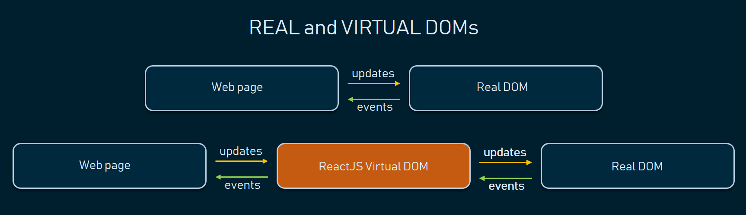
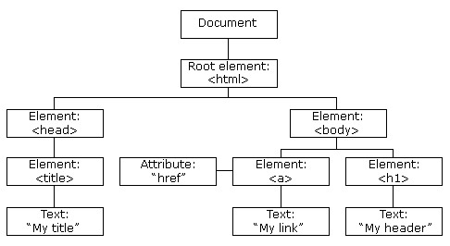
What is Real DOM?
The Document Object Model (DOM) is a programming interface for HTML and XML documents. It represents the page so that programs can change the document structure, style, and content. The DOM represents the document as nodes and objects. That way, programming languages can connect to the page.
What is Virtual DOM?
The Virtual DOM (VDOM) is a programming concept where an ideal, or “virtual”, representation of a UI is kept in memory and synced with the “real” DOM by a library such as ReactDOM. This process is called reconciliation.

Slide 16
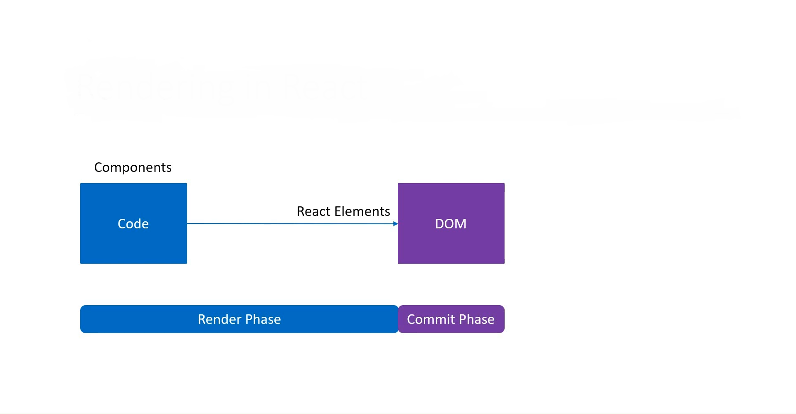
Rendering in React

Slide 17
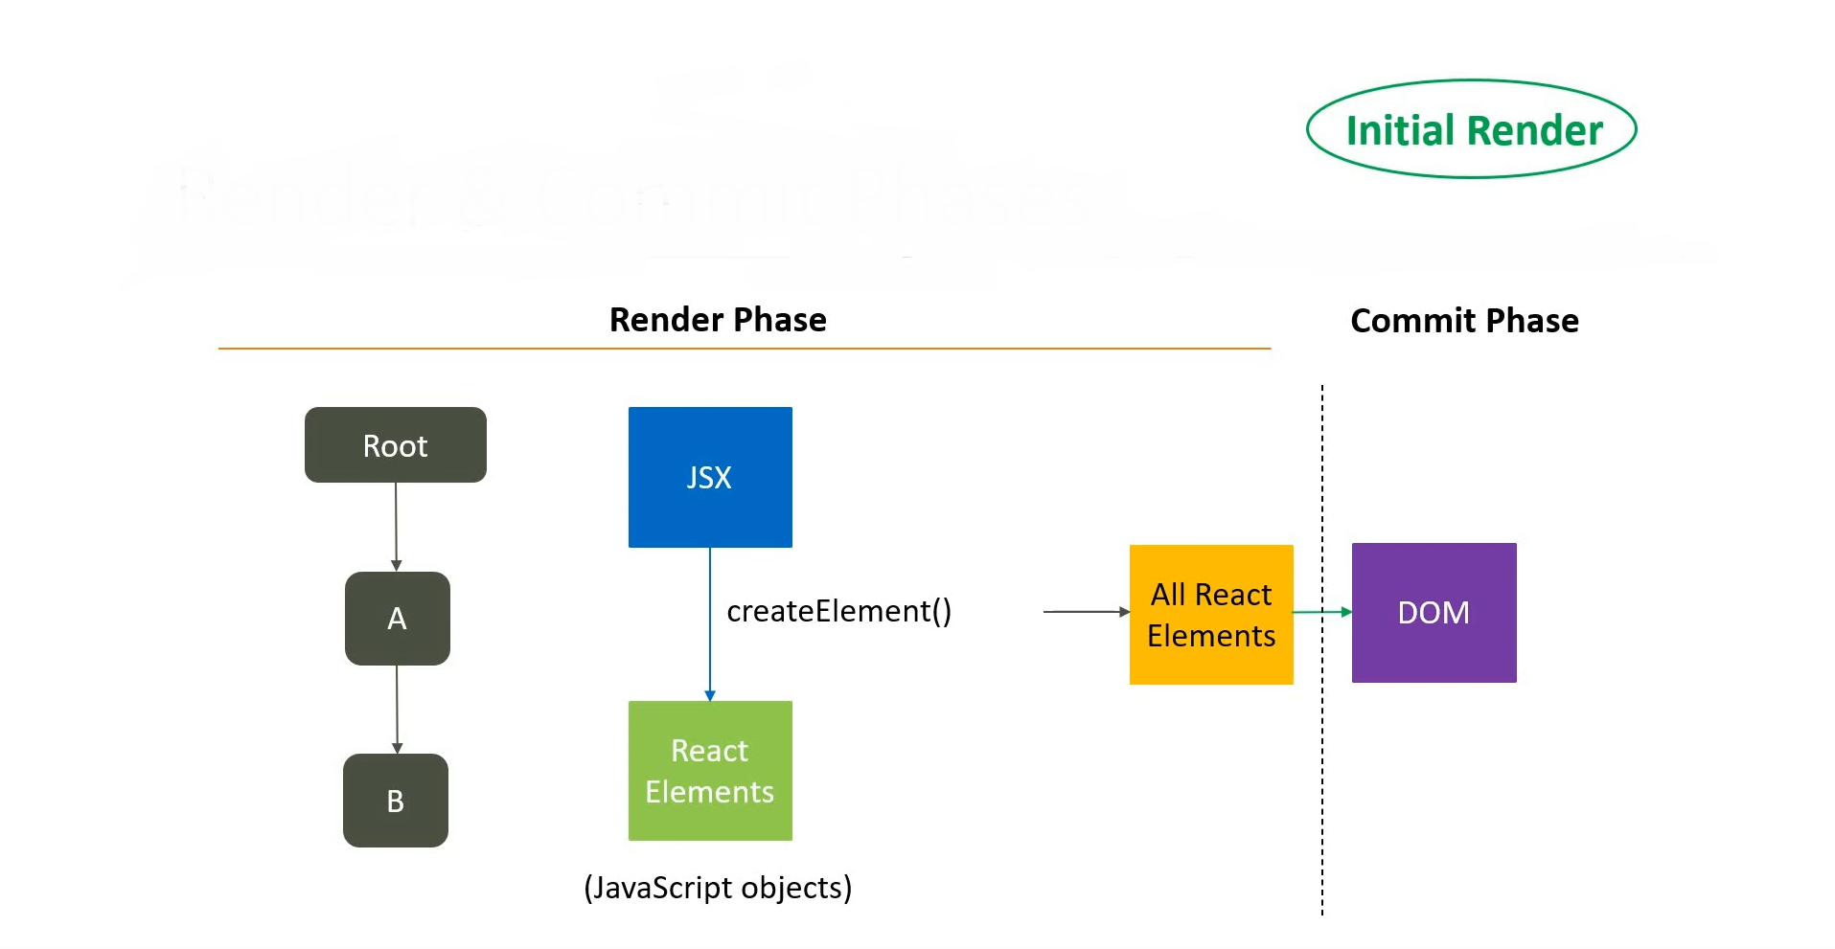
Phases: Render & Commit (Initial)

Slide 18
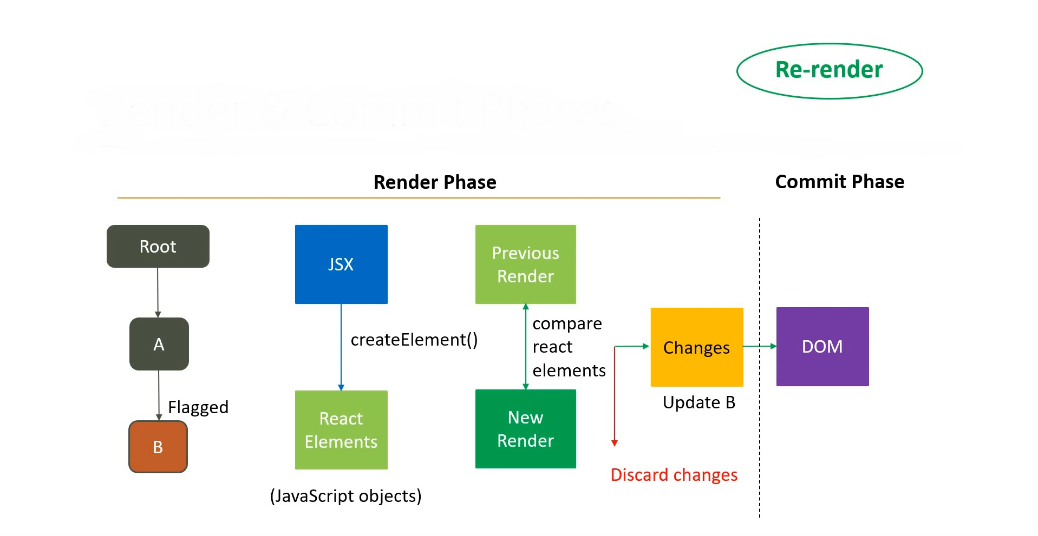
Phases: Render & Commit (Update)

Slide 19
Re-rendering Scenario
Render Phase:-
Find all elements flagged for updates.
For each flagged component, convert JSX to React elements and store the results.
Perform reconciliation- Diff old & new tree of react elements (aka Virtual DOM).
Hand over the changes to the next phase.
Commit Phase:-
Apply changes to the Real DOM.

Slide 20
Environment Setup & create-react-app CLI
Step 1: Download NodeJS. Link: https://nodejs.org/en/download/
Step 2: Open cmd prompt or terminal and enter the following commands: > npx create-react-app hello-react (OR) yarn create react-app hello-react > cd my-app
Step 3: Then enter the command: > npm start (OR) yarn start
This will launch the development server at http://localhost:3000.

Slide 21
JSX, Props & State

Slide 22
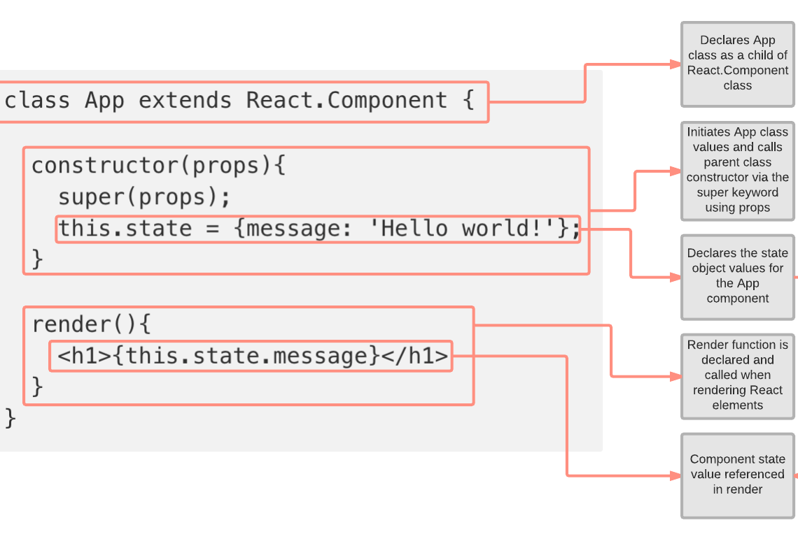
JSX JSX Allows us to include ‘HTML’ in the same file along with ‘JavaScript’ (HTML+JS=JSX). Each component in React generates some HTML which is rendered by the DOM.
Props Props are the read-only data which is passed from one component to another. Props are immutable.
State State is an updatable structure that is used to contain data or information about the component. It is the heart of the react component which determines the behavior of the component and how it will render.

Slide 23
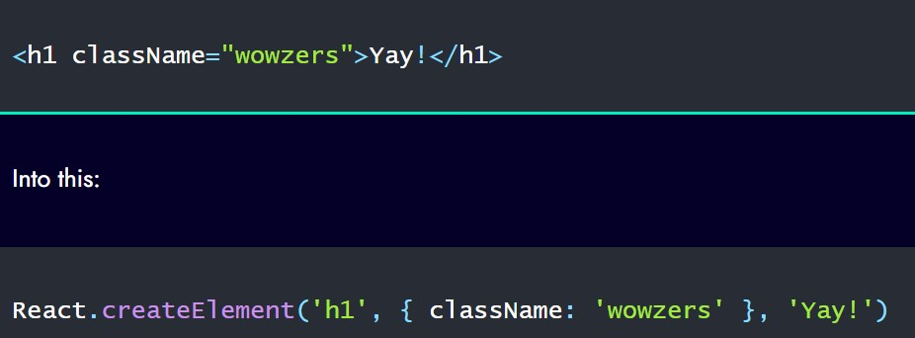
JSX Transform
Browsers don’t understand JSX out of the box, so most React users rely on a compiler like Babel or TypeScript to transform JSX code into regular JavaScript.
When you use JSX, the compiler transforms it into React function calls that the browser can understand. The JSX transform turns JSX in to React.createElement(…) calls.
Every JSX expression must have one Root element.

Slide 24
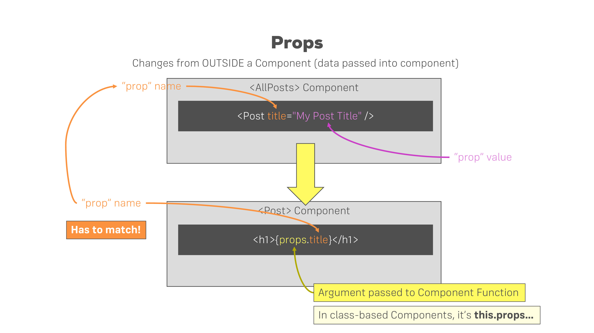

Slide 25
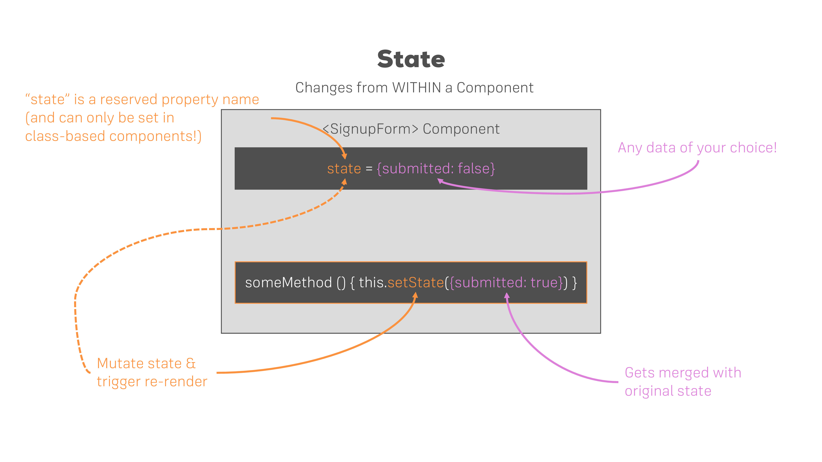

Slide 26
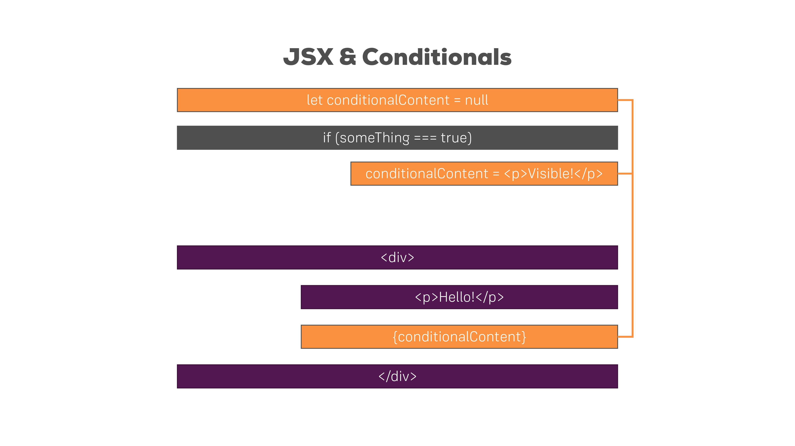

Slide 27
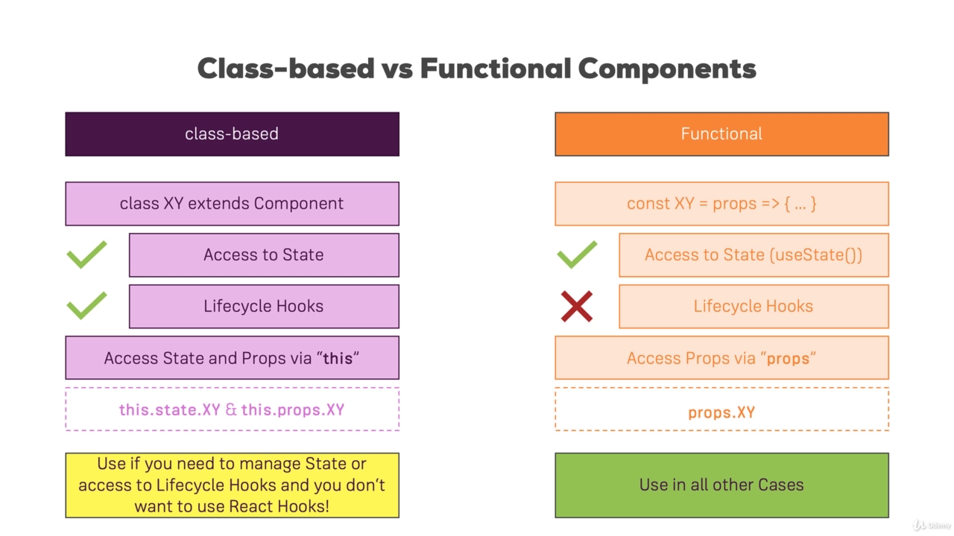
Stateful vs Stateless Components
A Stateful component is a component that manages its internal state. Typically, a Class-based component is Stateful component. They are also called Intelligent or Container components.
A Stateless component is a component that does not manage its internal state. Typically, a Functional component is a Stateless component. They are also called Dumb or Presentational components.

Slide 28
Refs & Keys

Slide 29
Refs
Refs provide a way to access DOM nodes or React elements created in the render method.
There are a few cases where you need to imperatively modify a child outside of the typical dataflow. The child to be modified could be an instance of a React component, or it could be a DOM element. For both of these cases, React provides an escape hatch.
When to use Ref:
Managing focus, text selection, or media playback.
Triggering imperative animations.
Integrating with third-party DOM libraries.
Avoid using refs for anything that can be done declaratively.

Slide 30
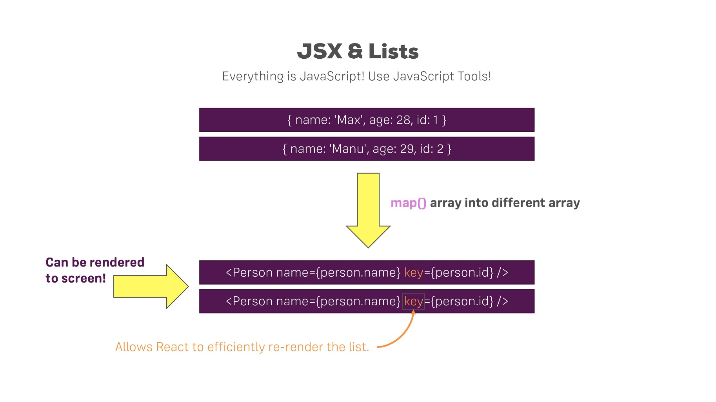
List & Keys
Keys help React identify which items have changed, are added, or are removed.
Key should be provided to every list item while rendering a list of HTML elements of React components to give them a stable identity.
A key should always be unique.
Keys help in efficient update of the User Interface.

Slide 31
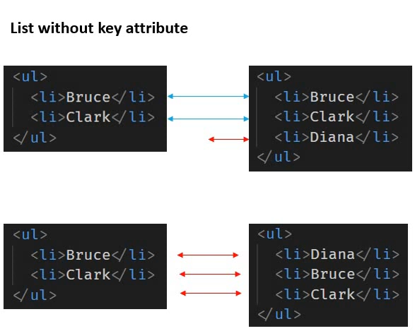
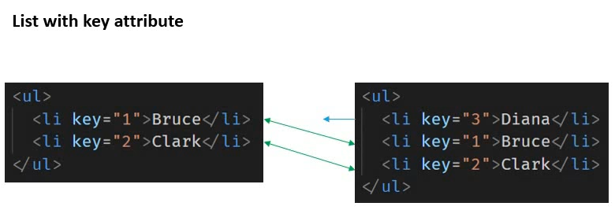
Why to use Key?

Slide 32
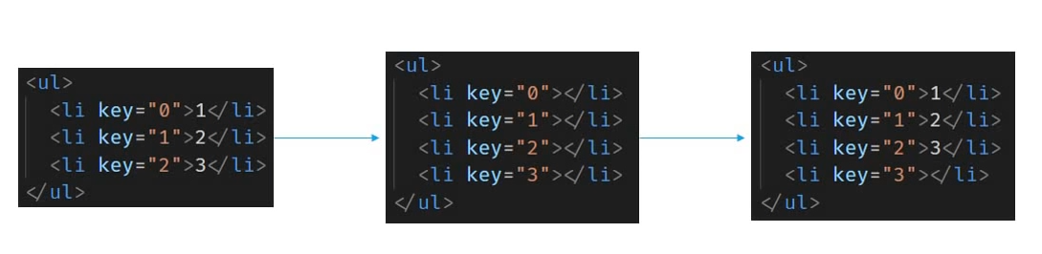
Why NOT to use Index as Key?

Slide 33
When to use Index as Key?
The Item in your list do not have a unique id.
The list is static and will not change.
The list will never be re-ordered or filtered.

Slide 34
Component Lifecycle

Slide 35
Each component has several “lifecycle methods” that you can override to run code at particular times in the process.
Mounting: These methods are called in the following order when an instance of a component is being created and inserted into the DOM.
constructor()
static getDerivedStateFromProps()
render()
componentDidMount()
Updating: An update can be caused by changes to props or state. These methods are called in the following order when a component is being re-rendered.
static getDerivedStateFromProps()
shouldComponentUpdate()
render()
getSnapshotBeforeUpdate()
componentDidUpdate()
Unmounting: This method is called when a component is being removed from the DOM.
componentWillUnmount()

Slide 36
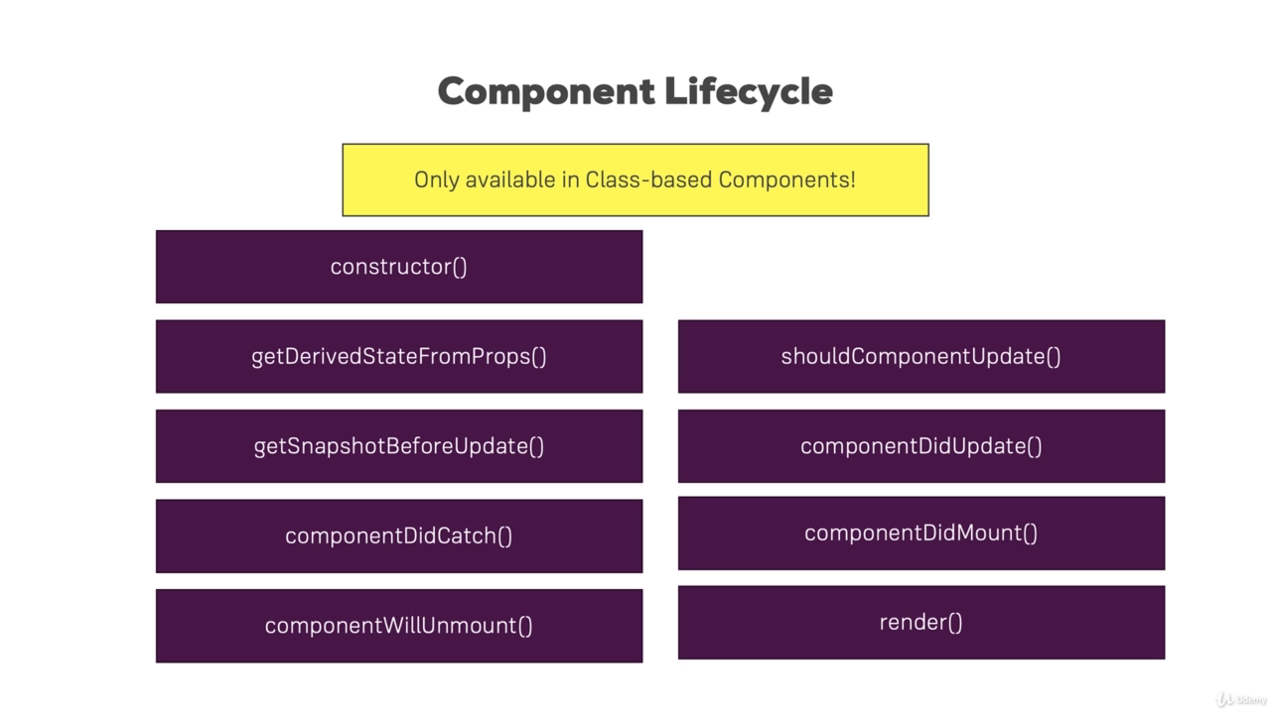

Slide 37
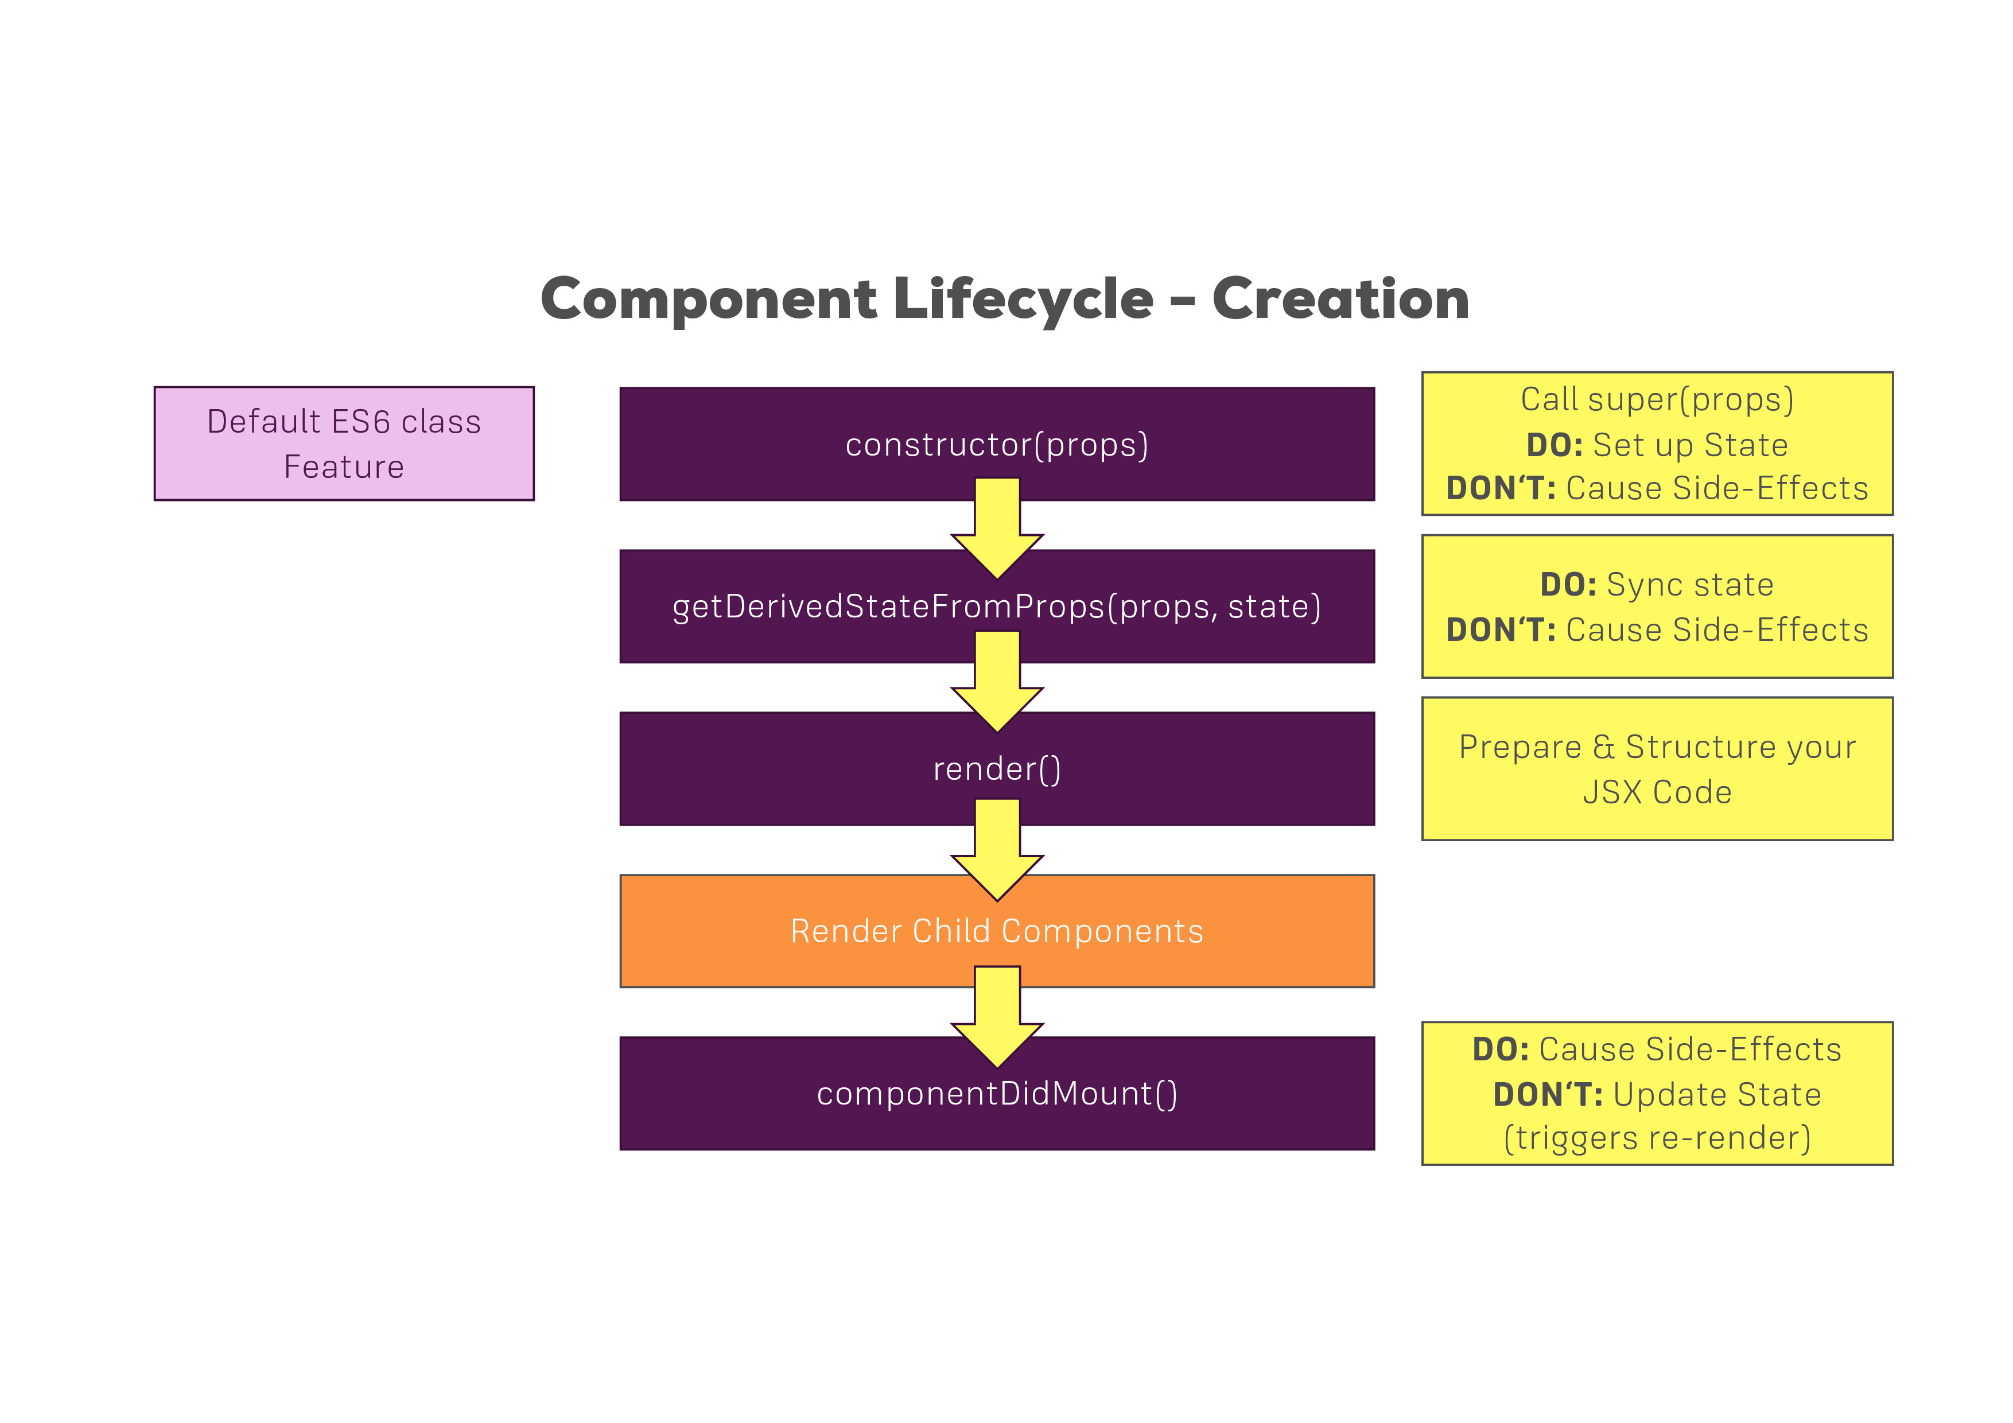

Slide 38
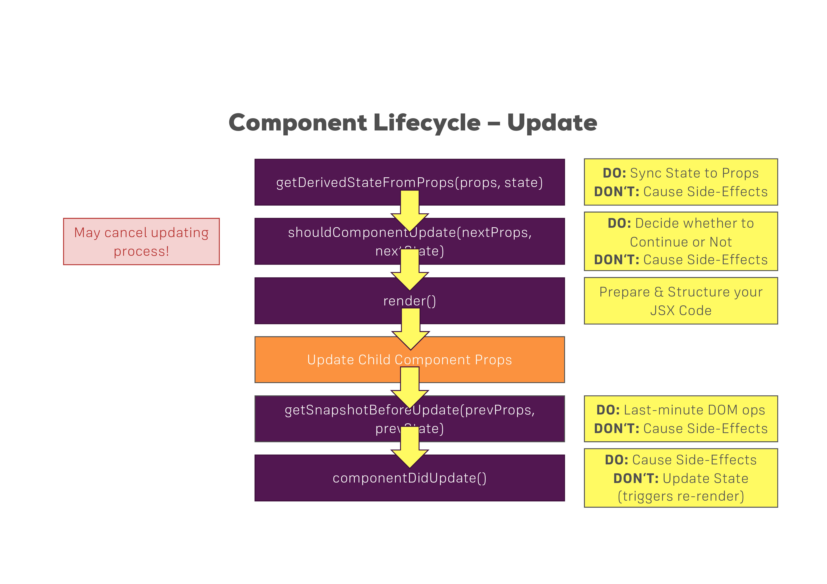

Slide 39
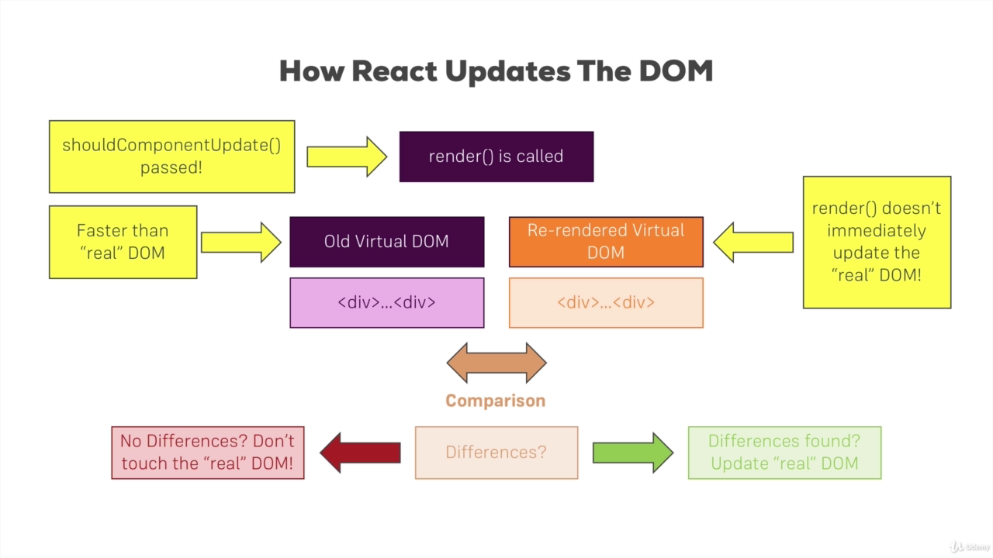

Slide 40
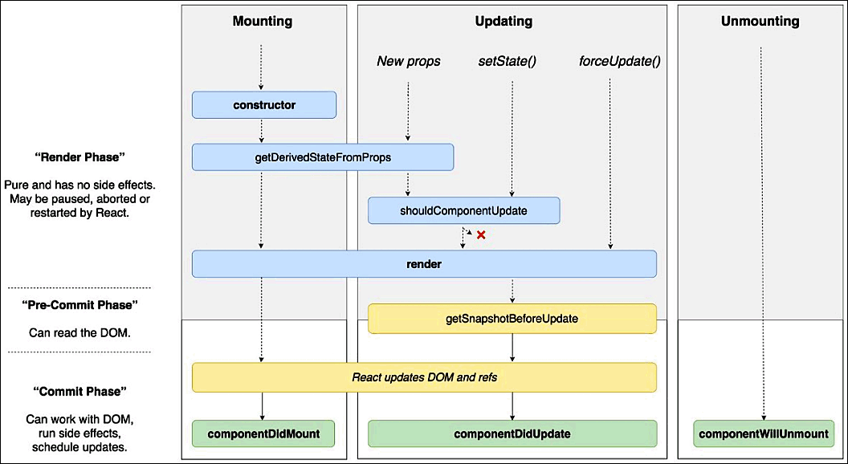

Slide 41
Please visit iEvolve Course: 63518

Slide 42
Thank You ☺

